Slide 1
NDTwin Network Digital Twin
P4 / bmv2 Data-Plane Support
— a second data plane, with nothing above it changed
Adam · 2026-08-19

Slide 2
Outline
0
Background
pp. 4–9
The system I inherited, the architecture, the stack, and the scale of what changed.
1
New capabilities
pp. 11–18
The P4 pipeline, the proxy agent, telemetry synthesis, liveness, failover, power.
2
Test tooling and documentation
pp. 20–23
The methodology, the five-layer harness, and what was written down.
3
Measured results
pp. 25–40
Differential testing, failover, throughput, load, twin accuracy — and a live demo.
2

Slide 3
SECTION 0
Background
The system I inherited, and where the P4 path attaches to it
3

Slide 4
Background: the system, and the task
NDTwin is a network digital twin — a live model of a running network, kept in step with it
1
A C++ kernel holds the model
The seven consumers
It owns the topology graph, ingests sFlow telemetry, tracks flows and link usage, and answers queries about the live network.
Energy-Saving-App
C++
Traffic-Engineering-App
Python
2
Seven components depend on it
Web-GUI
React / Node
Network-Traffic-Visualizer
JavaFX
Every one of them reaches the kernel only through the /ndt/ HTTP API — no shared memory, no shared files, no other channel.
Network-State-Recorder
Python
Network-Traffic-Generator
Python
3
The existing system drove OVS
Simulation-Platform-Manager
C++
Mininet with Open vSwitch, controlled by Ryu. Built by the lab before me; treated here as the given starting point.
All seven read the graph through /ndt/get_graph_data. If that endpoint breaks, all seven break at once.
4
My task
Make the same twin drive a P4 / bmv2 data plane as well — without the seven components having to change.
4

Slide 5
NDTwin: A Framework for Network Digital Twins
Traffic-engineering App
Energy-saving App
...
Apps (using simulation for prediction and optimal control)
Apps (using AI/ML model inference for prediction and optimal control)
NDTwin Apps
NDTwin Tools
NDTwin Kernel
Local LLM (fine-tuning)
Device configuration and power manager
Application registration and coordination manager
Intent to tasks translator
On-line LLM (e.g., ChatGPT)
Flow routing manager
Simulation request and reply manager
Topology and flow monitor
Simulation platform manager
Network traffic visualizer
Data cache manager
Controller and other events handler
Flow information and link bandwidth usage collector
Web GUI (supporting intent inputs)
Network state recorder
sFlow
SDN controller
sFlow
Emulated Network
(Mininet)
OpenFlow
OpenFlow
Physical
Network
Open vSwitch
or
Hardware switch
Network traffic generator
Open vSwitch
Hardware switch
Open vSwitch
Hardware switch
5

Slide 6
NDTwin: A Framework for Network Digital Twins
Traffic-engineering App
Energy-saving App
...
Apps (using simulation for prediction and optimal control)
Apps (using AI/ML model inference for prediction and optimal control)
NDTwin Apps
NDTwin Tools
NDTwin Kernel
Local LLM (fine-tuning)
Device configuration and power manager
Application registration and coordination manager
Intent to tasks translator
On-line LLM (e.g., ChatGPT)
Flow routing manager
Simulation request and reply manager
Topology and flow monitor
Simulation platform manager
Network traffic visualizer
Data cache manager
Controller and other events handler
Flow information and link bandwidth usage collector
Web GUI (supporting intent inputs)
Ryu-compatible REST
sFlow (synthesised)
Network state recorder
sFlow
SDN controller (Ryu)
P4 proxy agent
new
bmv2 emits no sFlow of its own.
The proxy synthesises it, so the kernel's collector cannot tell the two fabrics apart.
Emulated Network
(Mininet)
OpenFlow
P4Runtime
Emulated Network
(Mininet, bmv2)
Open vSwitch
or
bmv2 switch
Network traffic generator
Open vSwitch
bmv2 switch
Open vSwitch
bmv2 switch
6

Slide 7
Architecture: how P4 attaches to the existing system
The proxy agent impersonates Ryu's northbound API — nothing above the kernel changes
1
The proxy speaks Ryu, not the kernel
7 downstream apps
Topology, /stats/flow and destination paths are returned in Ryu's data shapes, so the kernel issues exactly the requests it has always issued.
/ndt/* HTTP API
2
sFlow v5 synthesised in the proxy
bmv2's sampled packets are synthesised into sFlow v5 and sent to the kernel's existing UDP:6343 collector, byte-layout compatible with OVS.
NDTwin Kernel
unchanged
3
Result: zero changes above the kernel
Ryu controller
existing
P4 proxy agent
new
Classifier, FlowLinkUsageCollector, every /ndt/ endpoint, the Intent Translator and all 7 downstream apps are untouched.
OVS switches
bmv2 switches
7

Slide 8
The stack
What the two data planes and the layer between them are built out of
Kernel
C++23
P4 data plane
P4_16
Proxy and control plane
Python
CMake
v1model architecture
FastAPI / uvicorn
build, with opt-in sanitizer targets
the target the pipeline compiles for
the proxy's north side
Boost.Beast / Asio / URL
bmv2 simple_switch_grpc
grpcio
the /ndt/ HTTP server
the software switch
the proxy's south side
nlohmann::json
p4c-bm2-ss
networkx
every request and reply
the compiler
graph state and BFS routing
spdlog
P4Runtime
Ryu / OpenFlow 1.3
logging, with a level-gated trap of its own
gRPC + protobuf control API
the API being impersonated
libssh
PRE clone session
sFlow v5
southbound to hardware switches
how telemetry samples reach the CPU
synthesised, not forwarded
GTest
Mininet
LLDP
603 cases
the fabric the switches run in
link discovery and liveness beacons
ASan / TSan
hypothesis
reproducible sanitizer builds
property-based topology tests
8

Slide 9
Scale of the work
377 commits, 2026-07-23 → 2026-08-19, on top of baseline 28b8b13
lines added
files
removed
Documentation
+46,290
207
−5
Runbooks, design and status docs, investigation records
Tests & tooling
+25,148
117
—
gtest suites, P4-proxy Python tests, the L0–L4 harness
Kernel (C++)
+6,068
56
−1,053
39 existing files modified, 17 new
P4 proxy
+4,431
26
—
All new — P4Runtime client, REST shim, sFlow emitter, P4 pipeline
Total
+81,937
406
−1,058
Diffed against baseline 28b8b13. Comment lines, blank lines and build artefacts are excluded; intelligent_router.py is excluded as the lab's pre-existing Ryu controller.
9

Slide 10
SECTION 1
New capabilities
The P4 pipeline, the proxy agent, telemetry synthesis, liveness, failover, power
10

Slide 11
1 · NEW CAPABILITIES
The P4 pipeline
Phase 4 — ndtwin_switch.p4, extended from a forwarding table into something that produces the same signal OVS does
1
A ternary 5-tuple table, ahead of LPM
Parser
Ethernet · ARP · IPv4 · TCP / UDP / ICMP
flow_5tuple carries a real priority and is evaluated before ipv4_lpm, so a specific flow rule wins over the default route rather than depending on table order.
flow_5tuple
ternary · real priority
2
Non-IPv4 frames are no longer dropped
ARP, TCP, UDP and ICMP are parsed, and an L2 table forwards what the IPv4 path cannot. Before this, anything that was not IPv4 disappeared silently.
ipv4_lpm
longest-prefix match
l2_forward
exact · non-IPv4 frames
3
Telemetry is generated in the pipeline
Direct and per-port counters, a TTL guard, and 1-in-256 clone-to-CPU sampling — the source of every flow sample the kernel later sees.
Egress
TTL guard · counters · 1-in-256 clone to CPU
482 lines of P4_16 / v1model, compiled with p4c-bm2-ss.
11

Slide 12
1 · NEW CAPABILITIES
Inside the pipeline
What a packet actually meets, in the order it meets it
Parser Ethernet · ARP · IPv4 · TCP / UDP / ICMP
Order is the design
flow_5tuple is consulted before ipv4_lpm, so a specific rule beats the default route without depending on table order.
MyIngress
packet_out? → leave on the port the controller named, return
IPv4? → flow_5tuple ternary, real priority
miss → ipv4_lpm longest-prefix match
Two exits before routing
LLDP? → send_to_cpu link discovery
A packet_out from the controller leaves immediately; LLDP goes to the CPU. Neither reaches the forwarding tables.
anything else? → l2_forward exact — non-IPv4 frames are no longer dropped
TTL guard inside the ipv4_forward action
1-in-256 → clone_preserving_field_list(I2E)
Cloning is not ours
Traffic Manager not programmable — the copy actually happens here
The ingress block only marks a packet. The Traffic Manager performs the copy, and that stage is not programmable.
MyEgress
is this a clone? → attach the packet_in header, and do not count it
otherwise → egress_port_counter
482 lines of P4_16 / v1model, compiled with p4c-bm2-ss.
12

Slide 13
1 · NEW CAPABILITIES
The P4 proxy agent
A FastAPI service that answers in Ryu's shapes on the north side and speaks P4Runtime on the south
1
Ryu's northbound API, reimplemented
Modules
lines
/v1.0/topology/*, /stats/flowentry/*, /stats/flow/<dpid> and destination paths, all returned in the exact shapes Ryu produces — including its string-action flow format.
topology_manager.py
Graph state, BFS routing, LLDP beacons
1,392
p4_client.py
P4Runtime gRPC, clone session, packet-in split
587
sflow_emitter.py
sFlow v5 synthesis
448
2
P4Runtime on the south side
ryu_topology.py
/v1.0/topology/* in Ryu's shapes
338
gRPC to bmv2's simple_switch_grpc. Switch connections are opened concurrently at startup, and every unary call carries a deadline so one dead switch cannot stall the rest.
main.py
Startup, concurrent switch connect
305
api_routes.py
/stats/flowentry/*, /p4/*
256
ryu_flow_stats.py
/stats/flow/<dpid>, string-action form
190
kernel_notifier.py
Pushes switch and link events north
144
3
Only /p4/ is new vocabulary
Where Ryu has no equivalent to impersonate — switch liveness — the endpoint is namespaced under /p4/ rather than pretending to be something Ryu offers.
Current file sizes, not diff counts.
13

Slide 14
1 · NEW CAPABILITIES
sFlow synthesis, and how it was proven
bmv2 emits no sFlow of its own — so the proxy manufactures it, byte-compatible with what OVS sends
1
Valid sFlow was not enough
sflow_emitter.py
Python — synthesised datagram
The kernel's decoder is a hand-rolled fixed-word-offset parser, not a general sFlow library. The datagram must have the same shape OVS produces — two flow records, extended_switch then raw header.
The kernel's C++ sFlow parser
the real one, not a stub
2
Agent addresses come from the same file
The kernel attributes a sample to an edge by AgentKey{agentIP, port}. An address it does not recognise yields telemetry attributed to nothing, with no error — so the emitter reads the topology JSON the kernel reads.
Parsed flow matches what was sent
3
Proven by cross-language round trip
Two independent checks
The Python emitter's real output is fed through the actual C++ parser the kernel uses, and separately compared byte for byte against datagrams captured from a working OVS run.
Round trip
test_SFlowEmitterRoundtrip.cpp
Byte compare
test_sflow_emitter.py vs OVS capture
14

Slide 15
1 · NEW CAPABILITIES
The telemetry sample path
From a sampled packet in the pipeline to a flow the kernel can attribute
1
A PRE clone session, programmed over P4Runtime
bmv2 pipeline
1-in-256 clone to CPU
Session 250 is what the pipeline clones sampled packets into. It lives in the pipeline's PRE, so bmv2 rejects it if no pipeline is loaded — the proxy programs it only after it has pushed the config itself.
PRE clone session 250
programmed over P4Runtime
2
Samples and packet-ins share one channel
Both arrive as packet_in. They are separated by a reason field, and the split matters for load as well as correctness: sampling is 1-in-256 of all traffic, so letting samples reach the LLDP parser would bury discovery.
packet_in
split on reason
3
A trap worth naming
Telemetry
→ sFlow emitter
LLDP
→ discovery
A third controller header compiles cleanly but is silently ignored — P4Runtime matches controller headers by name, and only knows packet_in and packet_out.
Verified on ten live bmv2 switches: 2,700 packets over ten hops produced 107 samples against a model prediction of 105.
15

Slide 16
1 · NEW CAPABILITIES
Liveness: how the twin decides a bmv2 switch is alive
Two independent kinds of evidence, and a verdict that is allowed to come back “cannot tell”
GATHERED BY THE PROXY
p4_client.probe() — every 2 s
an LLDP beacon arrives
GetForwardingPipelineConfig with COOKIE_ONLY: the cheapest request P4Runtime has,
and a real answer from the switch. → probe_ok, probe_age_s
packet_in with reason = LLDP, recorded unconditionally rather than
only when the edge is new. → last_lldp_age_s
GET /p4/switch_state — evidence, not a verdict
the kernel polls this and decides — nothing above this line changes
DECIDED BY THE KERNEL
probe_ok is absent or not a boolean
yes
UNKNOWN
Reporting Down here would mark the whole fabric dead for the first seconds of every run.
no probe of this switch has completed yet
no
The only signal that proves a bmv2 process is serving. gRPC channel state was rejected: it sits in IDLE until something forces a connection.
probe_ok == true
yes
UP
an RPC was round-tripped
no
The proxy’s poller has stalled. That is a fact about the poller, not about the switch.
probe_age_s > 15 s
yes
UNKNOWN
kProbeStaleSeconds — the last probe result is stale
no
bmv2 can answer control-plane RPCs while forwarding badly, and a loaded switch can miss one deadline while forwarding well. Fresh beacon against failed probe is a disagreement, not a verdict.
last_lldp_age_s ≤ 12 s
yes
UNKNOWN
kLldpFreshSeconds — a beacon arrived after the probe failed
no
Four ways to fail to know, and only one way to be told a switch is dead.
DOWN — asked, and nothing else disagreed
Up → setVertexUp
Down → setVertexDown
Unknown → the graph is not touched
16

Slide 17
1 · NEW CAPABILITIES
Failover: what turns a missing beacon into a new route
bmv2 raises no link-down signal, so the absence of a packet the proxy sent itself is the only evidence there is
Beacon out — every 5 s
TopologyManager sends one LLDP frame out of every port of every switch, as a packet_out.
Beacon in
The neighbour’s pipeline sends it to the CPU port. It arrives as packet_in with reason = LLDP,
and stamps the arrival time of that one link direction.
Watchdog pass — every 5 s
now − last beacon > 15 s ?
Why three and not one. One interval of tolerance would report a failure every time a scan landed just before a beacon did — and a flapping link report is worse than a slow one, because each one tears the edge out of the graph and recomputes every path.
no
Three missed beacons. A link that has never spoken at all gets 30 s instead.
yes
The link’s belief flips to down, and the kernel is told
POST /ndt/link_failure_detected, retried on every following pass until the kernel accepts it — a kernel
that happened to be restarting would otherwise cost the notification permanently.
The one measured failure mode. Taking a bmv2 interface down stalls that switch’s whole packet-in path, so every link into it falls silent at once — one real break produced five down directions, three of them healthy links whose beacons simply had nowhere to be delivered. Reporting may over-report safely; reprogramming may not.
every inbound link of that switch went quiet, and probe_ok is still true ?
yes
reported, not rerouted
Then this is a switch-level symptom, not a link failure — report it, but leave its links in the routing graph.
no
install_initial_routes() — reprogram first
BFS over the graph with the down endpoints removed, so a reinstall cannot recompute the same route
back into the broken link. insert_ipv4_route falls back to MODIFY, so the pass is idempotent.
The order is the point. The push advertises the routes that are installed, so announcing first would publish a snapshot that is honest and already out of date — and the corrected one would not arrive until the next transition.
push_destination_paths() — announce second
POST /ndt/inform_all_destination_paths. The kernel’s own pull runs every 60 s, so this only buys latency.
Detection costs between the timeout and the timeout plus one scan — 15 to 20 s by the constants, 10.7 to 14 s measured. Which of those two is right is not yet settled, and tuning the timer before it is would leave us unable to say what moved.
17

Slide 18
1 · NEW CAPABILITIES
Phase 7: switch power management
A twin has to be able to switch a node off and take it back again — and the order those steps land in is part of the mechanism
1
Power off, and keep enough to come back
Live acceptance
The ndtwin-p4-power helper shuts a bmv2 switch down entirely while preserving the state needed to restart it. A switch that is off disappears from /v1.0/topology/switches rather than staying in the list pretending to exist.
The switch was held off for
135 s
From power-on to fully re-adopted
1.50 s
2
Re-adoption after a restart
The graph was sampled at 10 Hz for
678 readings
POST /p4/readopt/{dpid} rebuilds mastership, the pipeline, the clone session and the routes. It is one call because those four have to happen in that order, and a partial re-adoption is worse than none.
Readings that wrongly showed it up
0
Re-adoption is one call, not four, because mastership, pipeline, clone session and routes have to land in that order — and the 10 Hz sampling is there to prove the graph never flickered up in between.
3
A known 30-second window, stated plainly
Re-adoption reports "adopted, routes not yet installed" while the links are still being rediscovered by LLDP. The gap is expected and observable rather than hidden.
Phase 7 and Phase 8 are both complete. Phase 3 — proxy endpoint completion — is the only one not started.
18

Slide 19
SECTION 2
Test tooling and documentation
The five-layer harness, what each layer gates, and what was written down
19

Slide 20
2 · TEST TOOLING AND DOCUMENTATION
The methodology is the real technology
Four ideas, each one replacing a judgement call with something that can fail
1
Differential testing
2
Mutation testing as an acceptance gate
The OVS path is known-good, so its behaviour is the specification the P4 path is checked against. No separate spec to write, and no argument about what correct means.
A test does not count until it has been watched failing: break the implementation, see it go red, restore. The evidence is filed per test.
The same method timed the inherited router at 180.75 s × 3 against 51.8 s now — no claim about anyone’s code required.
This caught eleven tests that passed while proving nothing at all.
3
Allowlist gates
4
Evidence-based design
Any warning or OVS/P4 difference not on a list is a failure. Every accepted difference has to be written down as a sentence with a reason.
Liveness has three states, not two. Southbound calls return OpResult, not bool. "I could not tell" and "it failed" are never allowed to render as "it worked".
New problems cannot hide inside old noise.
Liveness on page 16 is the instance of this that carries the most weight.
20

Slide 21
2 · TEST TOOLING AND DOCUMENTATION
Five layers, five different questions
Different failure modes surface at different stages, and each layer costs a different amount to run and to debug
Layer | The question it answers | Cost | Mininet
L0 Build check | Does every component still compile? | seconds–minutes | no
L1 Unit tests | Is unit behaviour correct — and still correct in a shared process? | ~2 minutes | no
L2 API contract | Does /ndt/* honour its structure, invariants and error paths? | needs a running stack | yes
L3 Component contract | Change one endpoint — which of the seven components break? | needs a running stack | yes
L4 Differential | Does the P4 path behave like the known-good OVS path? | full stack + traffic | yes
21

Slide 22
2 · TEST TOOLING AND DOCUMENTATION
What the suite contains, and what makes it trustworthy
A test count proves nothing on its own — so every test here was watched failing before it was allowed to count
603
453
243
7
gtest cases
P4-proxy tests
kernel-side Python
shell suites
in 47 files
in 17 files
in 7 files
orchestration and gates
1
Every test ships with the mutation that breaks it
Why the count moves
Applied, observed failing, reverted — and the evidence filed in four dated records under doc/audit/. This is what caught eleven tests that passed while proving nothing.
426 → 547 → 603 in seven days. That is real growth, not miscounting: three live defects each got a regression test, and four new tool suites arrived with their own.
2
The tooling's own false passes were fixed
Four of them. unittest counts skipped tests inside "Ran N", so a fully-skipped file printed green — and three tests sat below unittest.main(), so they had never executed at all.
The claim being made
Not "we have many tests". The claim is that each one has been observed failing for the reason it exists — which is a different and checkable statement.
3
Log output is a pass/fail gate, not a thing to read
check_logs.py fails on any warning or error not on the allowlist, has a FORBID list that overrides it, and treats crash signatures as unconditional failures that no allowlist can excuse.
22

Slide 23
2 · TEST TOOLING AND DOCUMENTATION
What was written down
Twenty-four documents under doc/, organised so that the next person has a route through
Operational — how to run it
Design and status
Investigation records
full_test_runbook
p4_bmv2_support_plan
p4runtime-mastership-spec-check
the whole stack, end to end
phase-by-phase plan and status
the conclusion that was withdrawn
ovs_manual_test_runbook
phase7_power_mechanism_design
bmv2-performance-report
the OVS round
the power path
the throughput A/B
p4_manual_test_runbook
ndt_api
src-ip-endianness-review
the P4 round
every /ndt/ endpoint, with byte-order and lock-type clarifications
a field that looked wrong and was not
environment_gotchas
HANDOFF
doc/audit/
sudo, pgrep, cleanup, ordering
what is still open
wedge trace, mutation evidence, scoped reviews
testing-manual
the current consolidated guide
The one that matters most is the one listing what is not done
test_coverage_gaps records what has no test yet, and HANDOFF records what is still open — including a defect found and deliberately left unfixed. A handover document that only lists successes is not a handover document.
23

Slide 24
SECTION 3
Measured results
Differential testing, failover, load, twin accuracy — and a live demo
24

Slide 25
3 · MEASURED RESULTS
The P4 path matches the OVS baseline
L4 differential: the OVS path is the specification, and every difference the P4 path shows has to be justified in writing or it fails
PASS
18
0
12
L4 differential
allowlist entries, each with a reason
unexplained differences
allowlist entries deleted once P4 caught up
1
The allowlist is the mechanism, not a formality
Why this is the strongest single result
compare_baseline.py fails on any difference not listed. Each entry is an endpoint, a regex and a reason, so "P4 cannot do this yet" has to be written as a sentence.
It is the only check that compares two independent implementations of the same behaviour. Unit tests confirm the code does what I thought it should; this confirms the P4 path does what the known-good path does — a claim I could not have written down myself.
2
Entries are deleted as phases land
Twelve were removed once P4 implemented what they excused — each re-verified against the live system first, not just crossed off.
TO ADD comparison output, difference table
PASS was recorded at dac192b and is stated as of that commit, not as a live status.
25

Slide 26
3 · MEASURED RESULTS
Failover, measured under controlled conditions
One fault model, one script, four cells, forty runs — the outage is timed from a continuous ping, not inferred from logs
Cell | n | Mean | SD | Range
P4 / 4 hosts | 10 | 13.68 s | 1.6 | 11.0 – 16.4
OVS / 4 hosts | 10 | 15.71 s | 1.5 | 13.7 – 18.1
P4 / 128 hosts | 10 | 16.59 s | 2.0 | 14.3 – 20.8
OVS / 128 hosts | 10 | 51.75 s | 3.3 | 47.0 – 56.4
What makes these hold
Continuous timestamped ping at 5 packets/s, so the outage is measured rather than inferred; the link to break is resolved at run time from the live path; netem re-checked every 5 s; recovery counted only while the fault is still present. “Recovered fully” is a filter rather than an impression — the raster only accepts a run with exactly one gap longer than a second, and all forty qualified.
At 4 hosts P4 is 2.0 s faster — 13%. Welch t = 2.89, p = 0.0098, 95% CI 0.55 – 3.50 s. At 128 hosts the gap is 3.12× and the two ranges do not overlap at all. Every one of the forty runs broke once and then recovered fully. (9467ea0 / b6b75fa / 213d209)
128 hosts was assumed to be too heavy
A comment in the topology script said bmv2 might not take it, and that assumption had gone unchecked. It takes it — 10/10 switches up, 16,256 paths converged in 11 s. What actually blocked the cell was four hard-coded four-host lists in three files.
What separating the variables shows
Scaling 4 → 128 hosts costs OVS 3.29× but P4 only 1.21×, so the interaction is larger than either main effect. "The data plane is the smallest of the three" is true at 4 hosts and false at 128 — the mechanism is not established, and the honest statement is that the two control paths degrade differently with scale.
Single fault, single host pair, single machine. Quote the interval, not the mean.
26

Slide 27
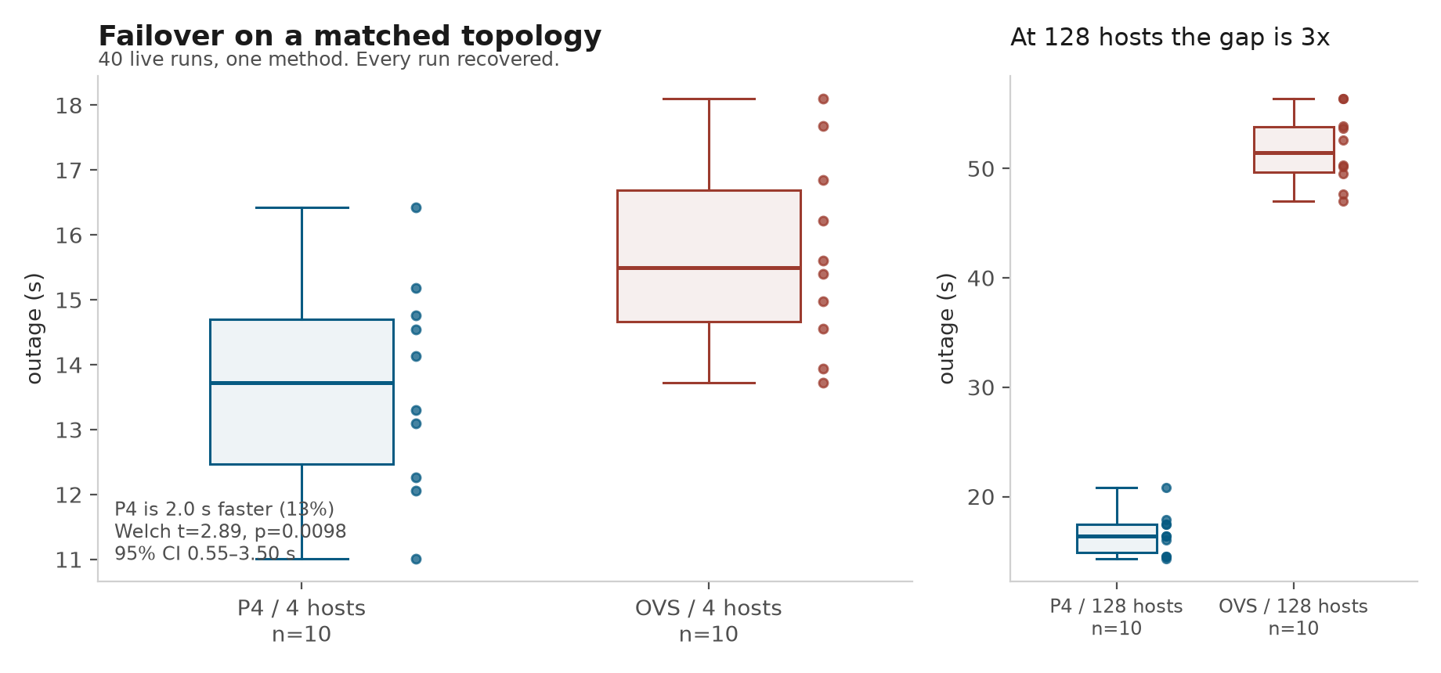
3 · MEASURED RESULTS
27

Slide 28
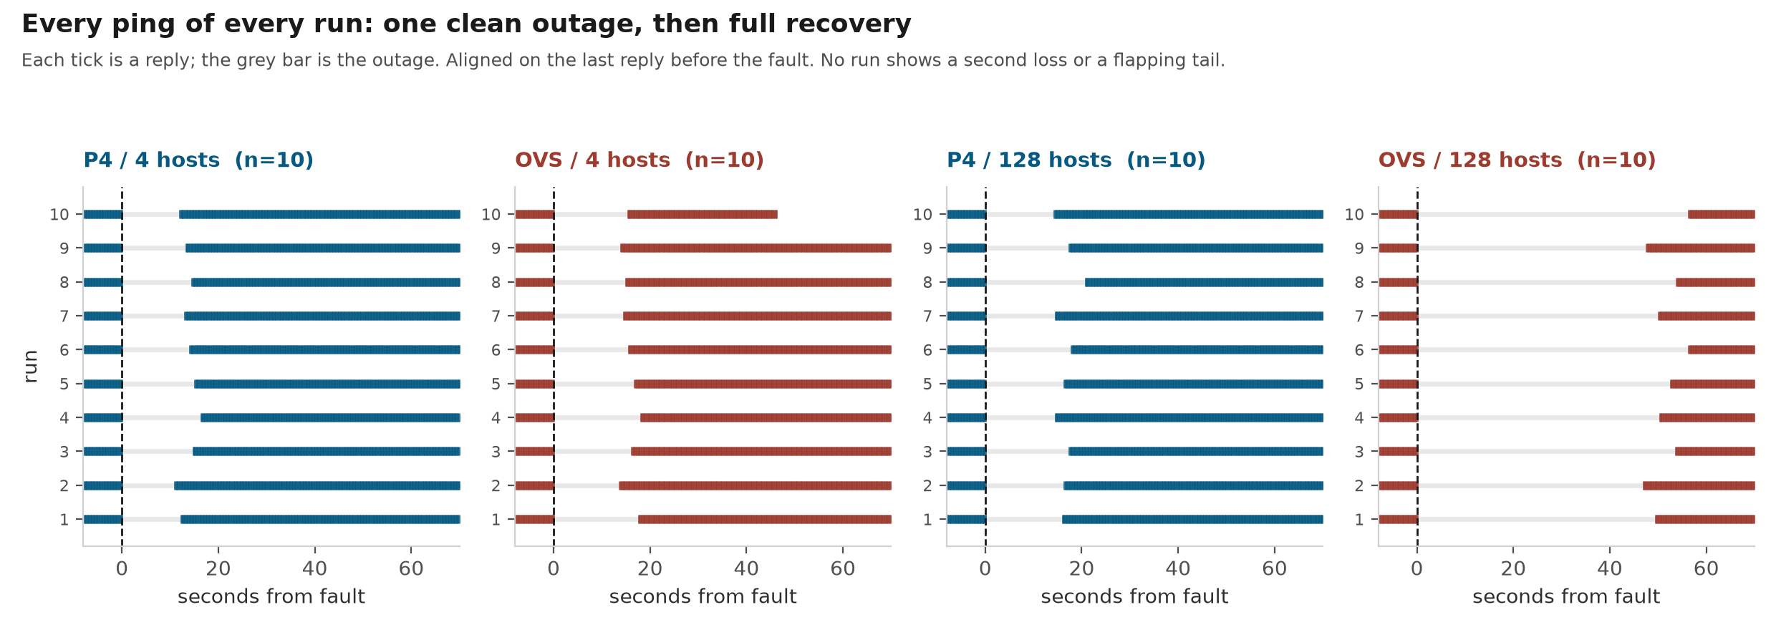
3 · MEASURED RESULTS
28

Slide 29
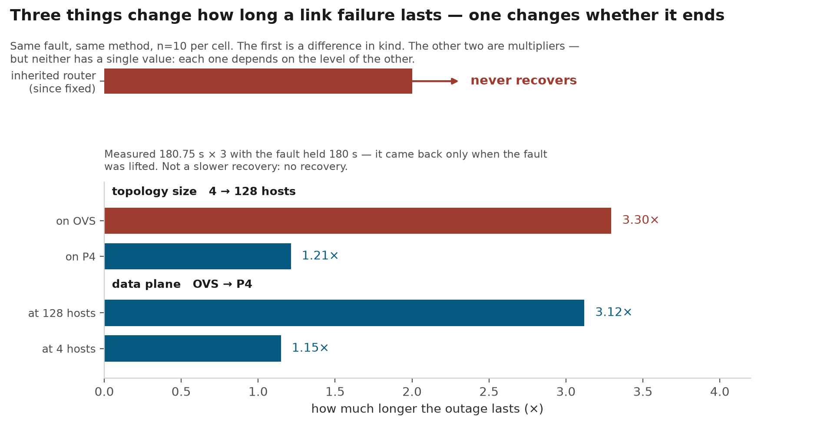
3 · MEASURED RESULTS
29

Slide 30
3 · MEASURED RESULTS
What the data planes can actually carry
Same fabric, same 3-hop path, same iperf3 script — two bmv2 builds and an OVS control
Build | Configuration | UDP delivered | TCP goodput | Packet rate
bmv2 — stock build | -O0, all logging | ~40 Mbps | 24.2 Mbps | ~3.6k pps
bmv2 — fast rebuild | -O3, logging macros disabled | ~460–530 Mbps | 431 Mbps | ~50.8k pps
OVS — control | shaped by TCLink at 1 G | 980 Mbps | — | —
1
The ceiling is packets, not bits
The published figure describes neither build
bmv2 is an interpreted reference implementation; at -O0 with logging macros the per-packet fixed cost dominates. 64-byte and 1400-byte frames hit the same packet rate, which is what identifies the limit.
~170 Mbps [2] is 4× above the stock build and ~3× below the fast one, so it is cited as an order of magnitude and nothing more.
2
The loss is invisible to interface counters
It happens in the first on-path switch's input buffer. h1 sent 89,296, s1-eth3 received 89,296 — and s1-eth1 transmitted 33,456. Nothing in between reports a drop.
What it costs the twin
At 1 Gbps declared, single-flow utilisation caps at ~4% on stock and ~43–53% on fast — so TE's 70% congestion threshold is physically unreachable on stock.
30

Slide 31
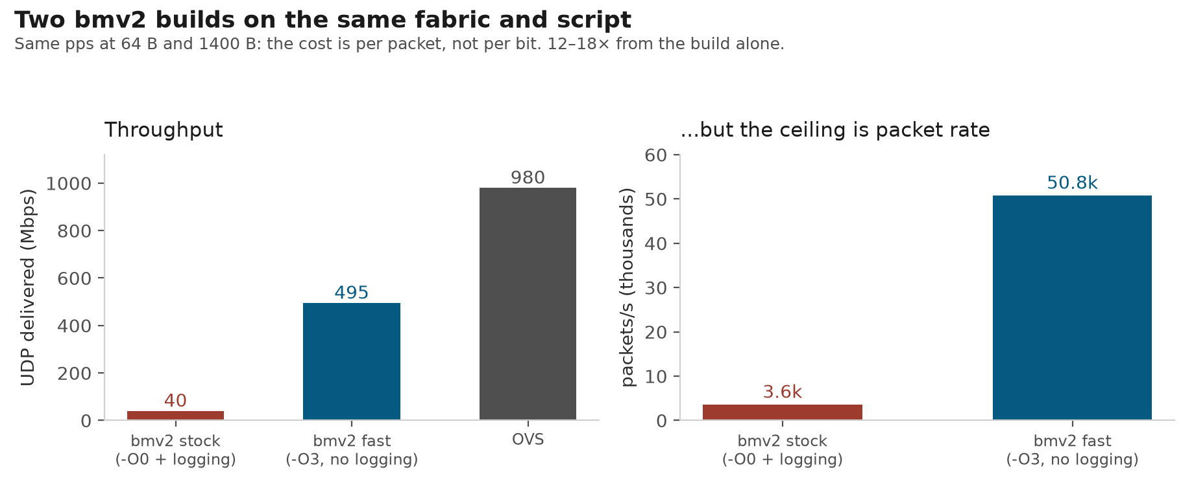
3 · MEASURED RESULTS
31

Slide 32
3 · MEASURED RESULTS
210 Mbps sustained, then a link broken underneath it
The earlier runbook only ever loaded one flow at 10 Mbps, and only broke links while idle
210 Mbps
288 / 288
0
2.7% / 0%
carried, four concurrent flows, five minutes
the graph never moved
spurious link events from Ryu
loss on the broken flow / the other three
1
Rerouting does not disturb traffic it is not rerouting
An old warning left standing
Breaking s1-eth2 under load cost 35,445 of 1,337,473 datagrams on the flow using it, and exactly zero on the other three — including the one sharing two switches with it.
The runbook records 100 Mbps starving LLDP badly enough that Ryu deleted 19 healthy links. Not reproduced here — but this was four 50 Mbps flows on different paths at half the per-flow packet rate, which is a different condition. The warning stays until someone reruns it as written.
2
The link-usage metric tracked the load correctly
About 5× for 20× the traffic, which is what the metric's own definition predicts: the denominator grows with the load.
3
One measurement points somewhere specific
The stale-path window reproduced at 14 s under load against 13 s idle — which points at a fixed cache period rather than anything load-dependent.
32

Slide 33
3 · MEASURED RESULTS
How accurate the twin's link usage is
Accuracy is not a number here but a curve — the estimate is unbiased, and its spread is the sampling-theory floor
Window | 200 Mbit/s ±% | theory | 20 Mbit/s ±% | theory
1 s | 20.7 | 23.9 | 70.9 | 75.6
10 s | 8.1 | 7.6 | 25.7 | 23.9
60 s | 3.1 | 3.1 | 6.8 | 9.8
150 s | 1.9 | 2.0 | 4.9 | 6.2
430 s | 1.2 | 1.2 | — | —
The sentence that survives questioning
Not "we are accurate to X%" — that number does not exist. The same instrument is ±21% at a one-second window and ±1.2% at 430 s. What can be claimed is: unbiased, with precision set by sample count, exactly as sampling theory predicts [1].
1
Unbiased across 430× of window and 10× of load
Where it stops working
Median ratio 0.97 – 1.02 at every window and both loads. Over 3,599 samples the mean reads 205.5 Mbit/s against a true 205.8 — 0.15% out.
On a 1 Gbps link a flow below about 3 Mbit/s is invisible and utilization_percent moves in 0.31% steps. A single one-second reading at 20 Mbit/s ranged from 0.15× to 2.38× of truth. And the four-host OVS cell has no sFlow configured at all: it reads zero, with status success.
2
The resolution floor is one sample
quantum = 256 × frame bytes × 8 — per-flow, not a constant: four runs gave 1490, 1490, 1494, 1506 bytes.
Measured at 04b8933 on the OVS 128-host topology, one fixed-rate UDP flow, no other traffic.
33

Slide 34
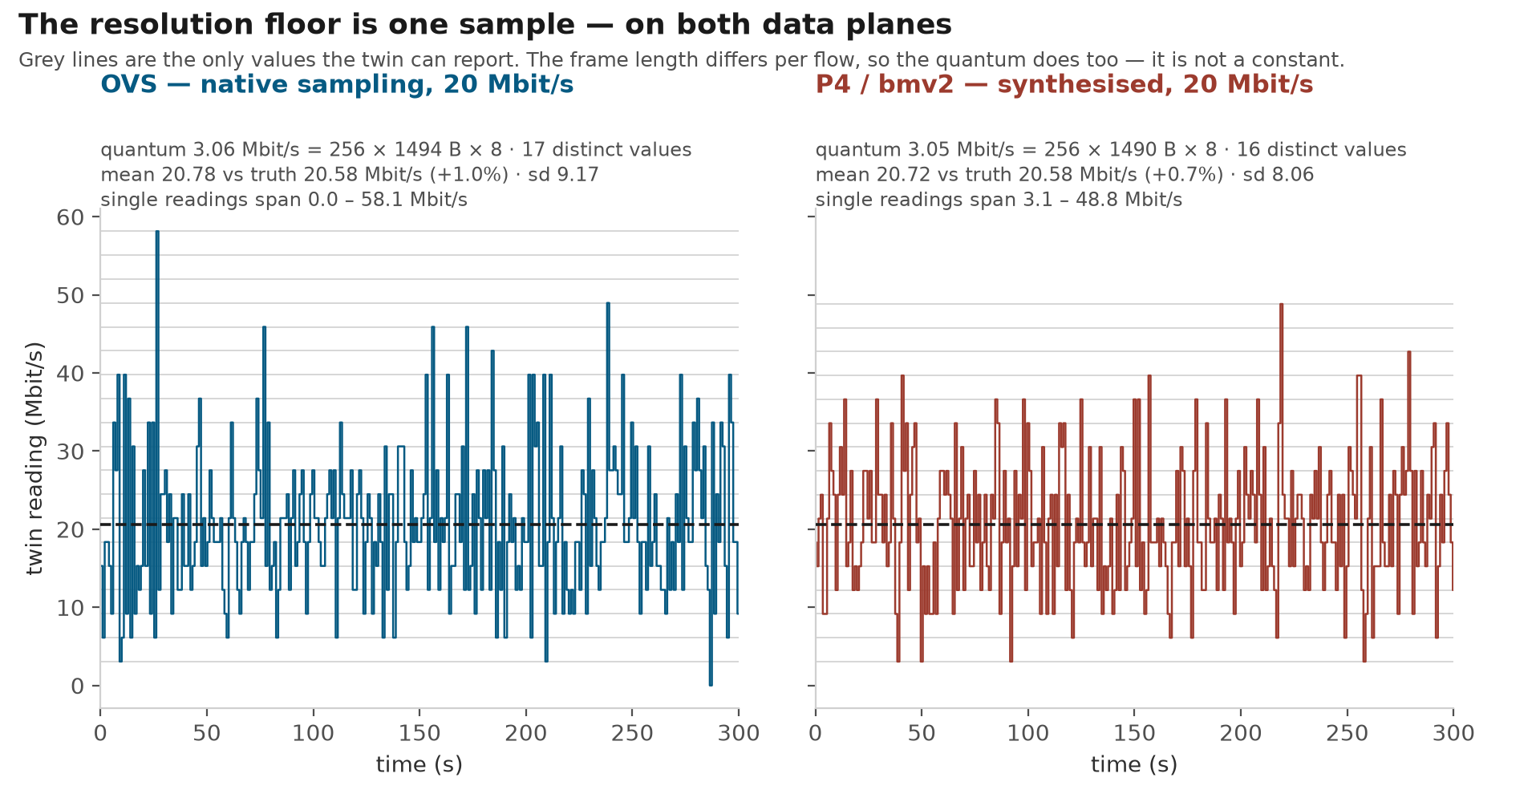
3 · MEASURED RESULTS
34

Slide 35
3 · MEASURED RESULTS
Synthesised telemetry against native
bmv2 emits no sFlow of its own, so the proxy manufactures it — this measures whether a manufactured sample is as good as a real one
Window | P4 median | OVS median | P4 ±% | OVS ±% | theory
1 s | 0.965 | 0.966 | 54.6 | 70.9 | 75.5
2 s | 1.001 | 0.967 | 47.5 | 51.3 | 53.4
5 s | 1.008 | 0.989 | 29.6 | 35.0 | 33.8
10 s | 1.016 | 1.022 | 20.1 | 25.7 | 23.9
30 s | 1.008 | 0.990 | 8.8 | 11.8 | 13.8
60 s | 1.003 | 1.007 | 6.3 | 6.8 | 9.7
One result I cannot explain yet
P4 sits consistently below the theoretical floor — 54.6% against 75.5% at one second — while OVS sits on it. Below the floor is not a problem, but the mechanism is unproven. One candidate is that bmv2's per-packet random() is not independent, making the sampling closer to systematic than Bernoulli. Reported as an observation, not a claim.
1
Synthesised is as unbiased as native
Why the two cells are comparable
Median ratio 0.97 – 1.02 at every window on both planes, each against its own measured ground truth of 20.6 Mbit/s. Both sample at 1-in-256, so the theory column is shared.
Different host counts, but the same switch core — ten switches, thirty-two inter-switch links — and the same 1-in-256 rate. Sampling precision depends on the samples taken on the link, not on how many hosts hang off it. The per-hop figure therefore shows four hops on OVS and two on P4: the flow is shorter in the smaller layout, and each panel is an internal comparison.
2
And it adds no error of its own
The P4 spread is at or below the sampling-theory floor at every window.
Measured at b6b75fa. P4 stock build, 20 Mbit/s, 600 s, 2,400 samples, none dropped.
35

Slide 36
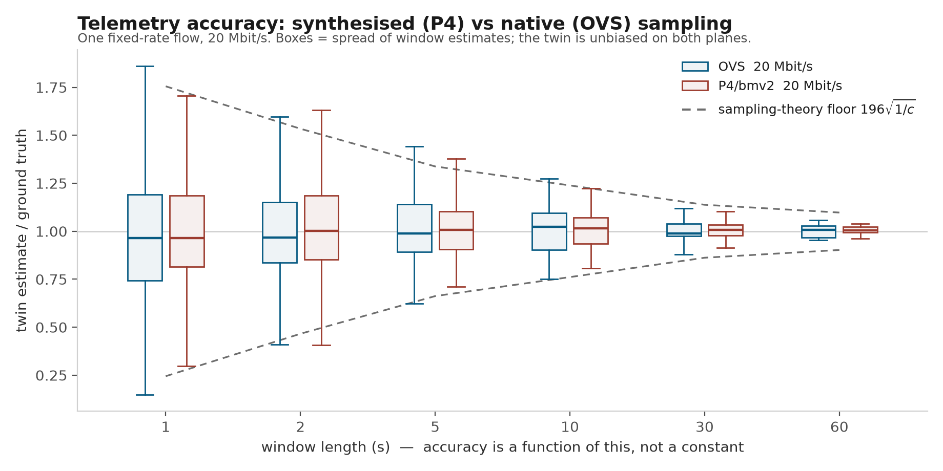
3 · MEASURED RESULTS
36

Slide 37
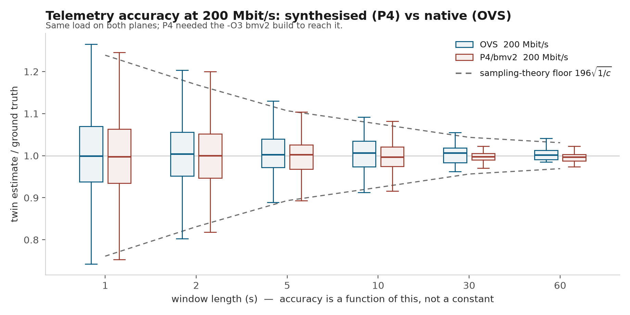
3 · MEASURED RESULTS
37

Slide 38
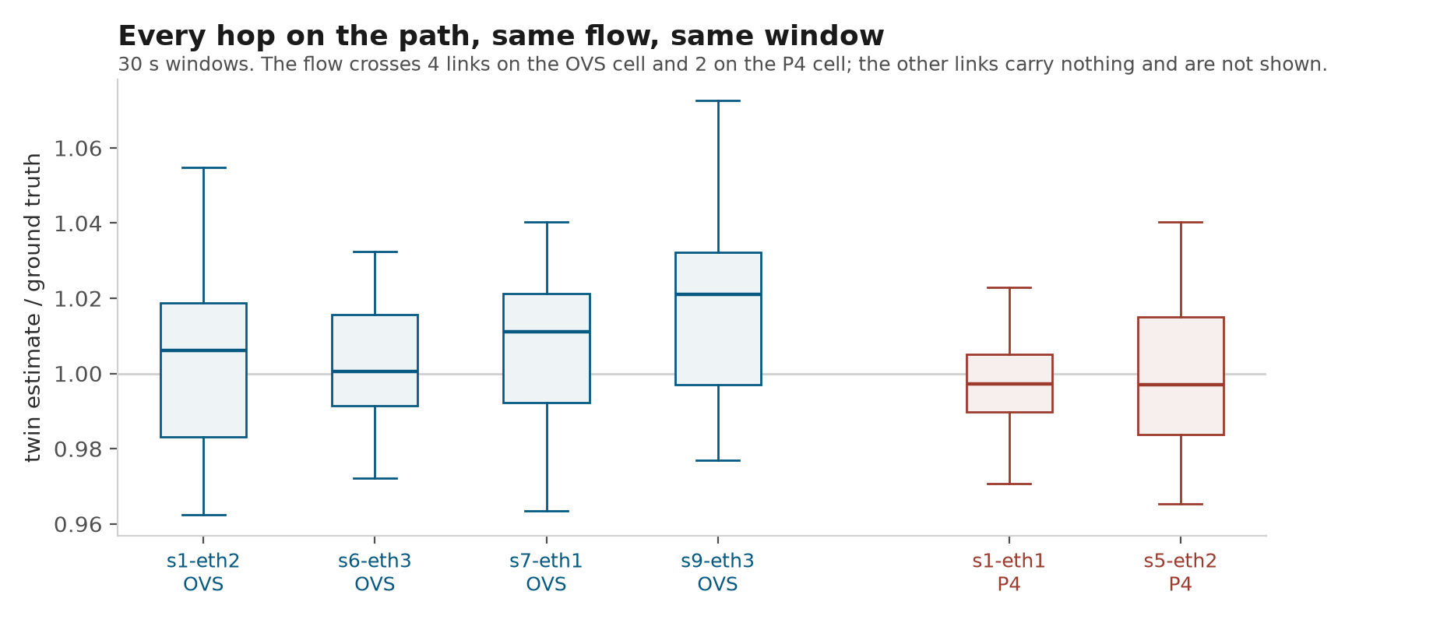
3 · MEASURED RESULTS
38

Slide 39
3 · MEASURED RESULTS
An independent pass over the running system
Read-only checks against the live OVS stack, run from a perspective that did not know the implementation
51
12
1
11
read-only checks against the live stack
findings raised
real defect — fixed
documented behaviour or false positives, each adjudicated
1
Every finding was adjudicated, including the wrong ones
Why an outside perspective was worth arranging
Eleven of twelve turned out to be documented behaviour or false leads. Each was run to ground and the verdict written down, because an unadjudicated finding is indistinguishable from an ignored one.
Everything else in this deck was verified by the person who wrote the code. That is a real limit, and the only way past it is to have something check the system without knowing what it is supposed to do.
2
A separate pass over unreviewed findings
Forty-seven high-severity items produced twenty-one real problems. That ratio is worth stating rather than reporting only the hits.
39

Slide 40
3 · MEASURED RESULTS
Demo
1
2
3
Link failure and reroute
The P4 fabric in the Web GUI
Liveness moving through three states
Break a single link, watch the twin detect it, reroute, and read the rewritten rule back over P4Runtime. Roughly 30 seconds end to end.
The same interface the lab already uses, driven by a data plane it was never written for — topology, flows and link usage, all through the unchanged /ndt/ API. The GUI is read-only, so anything that changes state is done from the Mininet CLI beside it.
Kill a switch and watch Up become Unknown before it becomes Down. Unknown is held while the LLDP beacon is still fresh and only becomes Down when it expires — so one failed probe never rewrites the topology.
TO ADD screen capture
TO ADD screen capture
TO ADD screen capture
Recorded, not performed
All three are procedures already written down and already executed on the live stack, each with its own recording runbook. What is shown is a replay of a recorded run rather than a new experiment carried out in front of an audience — the failure modes here are timing-sensitive, and a live attempt would be demonstrating luck rather than the system.
40

Slide 41
Where it stands
What shipped, what is deliberately unfinished, and what is simply unknown
Delivered
Open, and stated as open
A second data plane, with nothing above it changed
Locks have no owner
any caller can release any other caller's lock — and seven components share them
P4/bmv2 fully attached — the kernel, all seven components and the Intent Translator are untouched.
Queued flow endpoints
200 queued, but nothing can ask whether the rule landed
Power-on can be a no-op
within ~10 s of shutdown it returns Success and does nothing
The shared path made honest
The silent defects in the baseline are fixed, so the reference the P4 path is verified against can be trusted.
Proxy restart loses rules
every installed rule is dropped, and the twin reports full health
Phase 3
proxy endpoint completion — the only phase not started
Both data planes have a decidable health standard
Ryu wedge
root cause unproven after four falsified hypotheses
Five layers, differential comparison, and mutation evidence per test.
Election-id reuse
deliberately left; changing it means re-verifying re-adoption
The queued-endpoint gap is worse on OVS than on P4
popen("curl …")
22 sites across 3 files, deferred on purpose
Same rule, same 200 queued, both data planes. P4 writes "dispatched install failed"; OVS writes nothing at all — 16,324 log lines, zero errors, and the rule never installed. On OVS the gap is not just unqueryable, it is untraceable after the fact.
bmv2 stock throughput
~40 Mbps per switch — a design trade-off, not a defect
The four marked items were found in the last two rounds of live testing and are deliberately unfixed before this report. All seventeen open issues are collected in doc/KNOWN-ISSUES.md, ordered by whether normal operation reaches them.
Also worth asking about: a P4Runtime specification report was prepared and then disproved by its own final check before it was sent.
41

Slide 42
Future work
Three directions, at three different levels — a design problem, a structural problem, and an architectural one
1
Concurrency control has two blocked routes, and both are located
The pessimistic route: release_lock only checks that a lock exists, never who holds it — a second connection with no credentials released a live lock and took it. Adding an owner is not sufficient on its own: LockManager::renew checks isLocked but not expiry, so an already-expired lease can be renewed indefinitely and TTL stops meaning anything when a holder dies.
Next: an owner token plus a now < expiry guard. The optimistic route stays blocked until commit failures are detectable at all.
2
topology_manager.py carries three responsibilities in one class
1,516 lines covering graph and routing, LLDP and liveness, and rule translation. The evidence is already in the file: two mutually independent locks, one guarding the graph and one the liveness bookkeeping, with a comment stating they are never held at once.
Next: split along the line the two locks already draw. A class that needs two unrelated locks is usually two classes.
3
Asynchronous dispatch needs a completion handle
processFlowBatch returns 200 queued and the dispatcher sends afterwards, so a switch's rejection has no route back to the application. Both applications that write flows discard the response, so returning 202 instead would change nothing.
Next: a queryable job id or a synchronous path — a contract change across seven components, which is why it is future work rather than a fix.
Four smaller ones are written down but not on this slide: per-flow 5-tuple rules end to end, LLDP timer tuning judged on false-positive rate rather than detection time, telemetry accuracy with several flows and the applications running, and P4 measured beyond a single fault.
42

Slide 43
Planned for the next report
Three measurements already scoped — each one has a number it has to beat, and a way of being wrong
1
2
3
Find where the OVS 128-host recovery time goes
Make failure detection faster without making it wrong
Promote the fast bmv2 build to the default
OVS takes 51.75 s to recover on 128 hosts against P4's 16.59 s, with no overlap between the two ranges. The mechanism is not established, so the job is to attribute the time rather than explain it.
Detection is set by constants rather than by the network: the beacon interval is 5 s, and both the link timeout and the watchdog interval are derived from it. Three missed beacons before a link is called down.
Same fabric, same script: the stock build carries ~40 Mbps at 3.6k pps, the -O3 build with logging macros disabled carries 460–530 Mbps at 50.8k pps. The seam that switches between them already exists; the default is still stock.
Path computation is already excluded: the same fabric converges all 16,256 paths in about 13 s of real work on the Ryu side and 11 s on the P4 side.
The experiment is a sweep of the beacon interval at 5, 3, 2 and 1 s, measuring detection time and false positives at each.
It unlocks two things that are currently unmeasurable: TE's 70% congestion threshold, which is physically unreachable on stock, and telemetry accuracy with several concurrent flows.
Done when detection, recomputation and rule installation add up to the 51.75 s that was measured.
Judged on the false-positive rate, not the detection time. Detection time is certain to fall; a flapping link costs a global path recomputation.
Done when the whole L0–L4 suite passes on the fast build — changing the switch binary changes the timing every layer depends on.
One thing to settle before tuning anything: the code comment says detection takes 15–20 s and the last live round measured 10.7–14 s. Tuning a timer we cannot yet predict would leave us unable to say what moved.
43

Slide 44
References
[1]
Phaal, P. & Panchen, S. Packet Sampling Basics. sFlow.org.
The ±196√(1/c) floor used on the two accuracy slides
[1a]
Jedwab, J., Phaal, P. & Pinna, B. Traffic estimation for the largest sources on a network, using packet sampling with limited storage. HP Labs HPL-92-35, 1992.
The binomial argument [1] rests on
[2]
Chen, Hu & Jin. Performance Evaluation of P4 Programmable Switches in Emulation. ACM SIGSIM-PADS '23. doi:10.1145/3573900.3591120
The published bmv2 throughput figure
[3]
p4lang/behavioral-model, docs/performance.md — ~1047 Mbps / 80k pps for one simple_switch.
The upstream baseline for the A/B
[4]
Zhou, Yang, Duan et al. Network Digital Twin: Concepts and Reference Architecture. IRTF NMRG, draft-irtf-nmrg-network-digital-twin-arch-07, 2024.
The definition of the term, and the scalability caveat
[5]
faucetsdn/ryu, README — “The Ryu project needs new maintainers”, pointing to OpenStack os-ken.
Southbound dependency risk
Where the 196 actually comes from
It is not a result from a paper. [1] is a technical page with no publication date that gives no citation for the expression itself; the mathematics underneath is the normal approximation to a binomial, and 196 = 1.96 × 100, the 95% z value. Phaal is an author of both [1] and [1a].
44

